Slide 1
High Speed Computational Maths
Maths Society, IIT Delhi
12th August 2026

Slide 2
Cellphones on Airplane Mode and Stowed away

Slide 3
Vedic Maths is a Misnomer
No appendix in Atharva Veda
No mention of any 32 Sutras

Slide 4
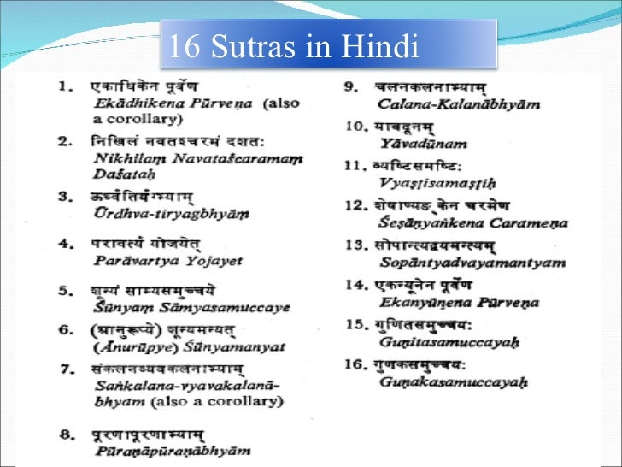
Vedic Maths Sutras
Make no sense even though we can read Devnagiri

Slide 5
Maths Etymology
To Think or Learn
Polymath is a very learned person
Phillomath lover of knowledge
Pantomath One who has learnt everything

Slide 6
Base Method
Base Numbers are 10 100 1000

Slide 7
Casting out 9s or Single Digits
14 + 12 = 26
- 12 = 2
Used in Division Veracity
Dividend = (Quotient x Divisor ) + Remainder

Slide 8
Vinculum Numbers
Numbers with + ve n - ve digits
+ 12 and -12 are normal +ve and – ve numbers
1 2 is a Vinculum Number
Value is 1 x 10 = - 10
2 x 1 = + 2
= - 8
Digits 6, 7, 8 n 9 are not used in High speed maths
Their 10s complements are used

Slide 9
Place value of digits
21 and 12

Slide 10
Distributivity Law
(x+y) z = xz + yz
(x-y) z = xz - yz

Slide 11
ADDITION
4 concepts

Slide 12
9
8
7
6
5
4
+

Slide 13
4999 + 5678

Slide 14
126 + 132

Slide 15
49 – 78 + 12 – 45
How would you solve it – assuming you had 5 digit numbers

Slide 16
SUBTRACTION
3 concepts

Slide 17
5001 - 4278

Slide 18
1 00 000 – 42 678

Slide 19
8 24 58 83
– 5 89 14 26

Slide 20
MULTIPLICATION
14 concepts

Slide 21
23 x 11 23 x 111
23 x 88 23 x 888

Slide 22
23 x 99 23 x 999

Slide 23
52² 59²

Slide 24
25² 85²
325²

Slide 25
88 x 5 88 x 25 88x125

Slide 26
17.5 % of 489

Slide 27
12 x 34 123 x 456

Slide 28
88 x 82 28 x88

Slide 29
98 x 97 102 x 103 102 x98

Slide 30
47 x 46

Slide 31
^{497 X 35 503 x 35}

Slide 32
Tables of 79 798

Slide 33
DIVISION
7 concepts

Slide 34
253 ÷ 11 253 ÷ 111

Slide 35
253 ÷ 9 253 ÷ 99

Slide 36
23 ÷ 101 253 ÷ 1001

Slide 37
48 ÷ 202

Slide 38
456 ÷ 978

Slide 39
6789 ÷ 98 6789 ÷ 102
6789 ÷ 32
6789 ÷ (32 x 3)
6789 ÷(32 x 4)

Slide 40
6789 ÷ 98
Vinculumise
Dividend
Divisor
And both

Slide 41
2871 ÷ 99 Computable in 2 seconds
1234 x 4321 Computable in1 minute
^{a) 5432114}
^{b) 5532114}
^{c) 5332114}
^{d) 5232114}

Slide 42
Am looking for collaborators on books, videos to simplify Maths

Slide 43

Thank You
Vishal Bhatia
87 99 7444 90

